Slide 1

{ async patterns }
- or -
using the asynchronous library in the .Net 4.5 Framework for more than keeping your UI responsive.

Slide 2
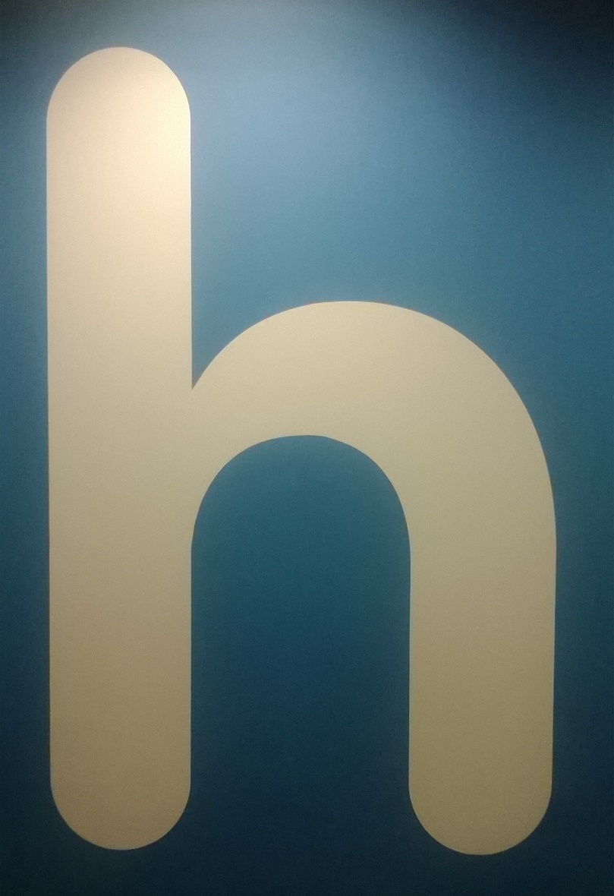
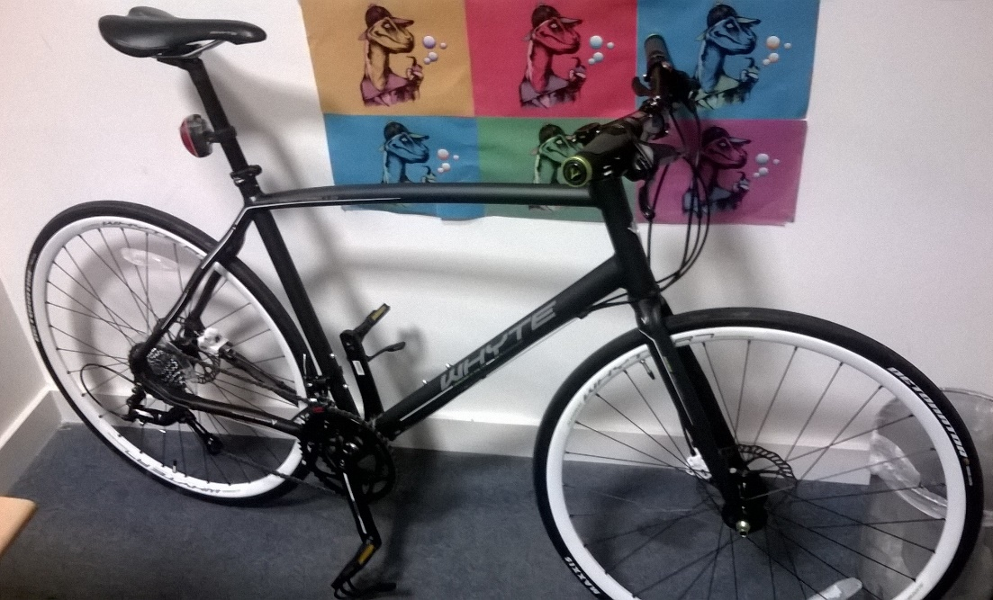
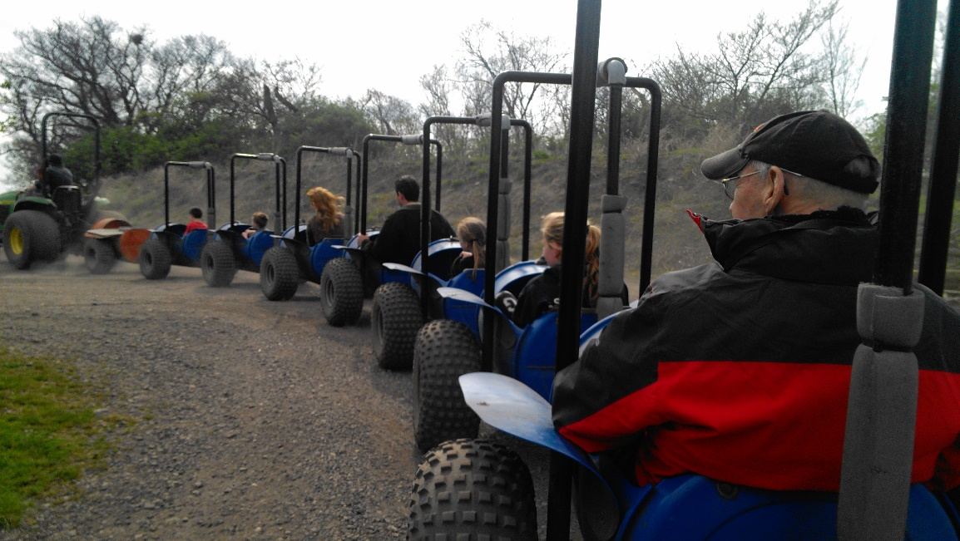
Who is Liam Westley?
< commute
play >
< work

Slide 3
{ async }
- quick recap, 2012 -
New asyhcronous library in .Net 4.5
Heavily used in WinRT and available from within Visual Studio 2012

Slide 4
{ async }
- April 2013 -
Now available Microsoft Async BCL
Requires Visual Studio 2012 but can target .Net 4, WP7.5, WP8, SL4, SL5

Slide 5
Key goals for async #1
Identify long running process and handle them asychronously
‘Long-running’ in the Windows Runtime it is specifically anything that could take longer than 50ms to execute

Slide 6
Key goals for async #2
An asynchronous programming model familiar to the way that you might write synchronous code
- lower barrier to entry

Slide 7
async
Indicates that a method is likely to contain a control flow that involves awaiting asynchronous operations

Slide 8
await
await signs up the rest of the method as a continuation of the task and returns to the caller
Possible to include more than one await within a single async method

Slide 9
Task Task<T>
Where you would have had a void return value, use Task.
Where you would have had a return value,or parameter output values, use Task<T>.

Slide 10
Task<T>
Using Task or Task<T> means we not only receive a return value, we can obtain additional information about the task performed by the async method, including detecting completion and handling exceptions.

Slide 11
Timeout<Code>

Slide 12
Sample.Data*
* Any resemblance to real frameworks, on github or codeplex, is purely coincidental even if they are written by @markrendle

Slide 13
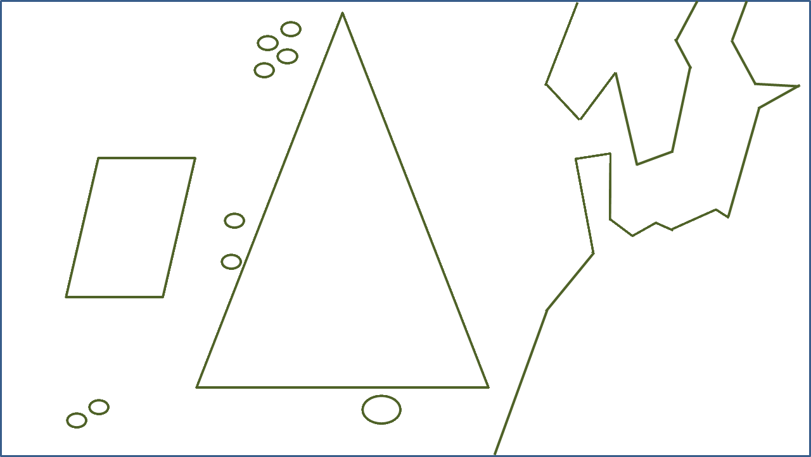
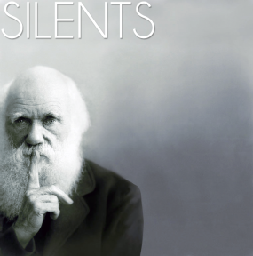
Oslo
Sheffield
http://silents.bandcamp.com
London

Slide 14
WhenAll
Useful for batch processing
all are important.
Sending a set of e-mails.
Batch lookups returning many values.
Notes:
Combinator methods – see The Task-based Asynchronous Pattern (TAP.docx) from Stephen Toub, February 2012.

Slide 15
Timeout<Code>

Slide 16
WhenAny
- Throttling -
Limiting network or file I/O, or preventing saturation of a CPU.
When encoding multiple MP3 files, you might use one or two less threads than the number of CPU cores to allow other process access to the CPU.

Slide 17
Timeout<Code>

Slide 18
WhenAny
- Redundancy -
Useful for competing services where the first to return wins
Multiple lookups where all are expected to return the same value - stock prices, geo lookup

Slide 19
Timeout<Code>

Slide 20
WhenAny
- Interleaving -
Perform additional processing on the results of tasks as they complete.
A web browser can make multiple HTTP requests, but will start building the page as each HTTP request returns data.

Slide 21
Timeout<Code>

Slide 22
WhenAny
- Early bailout -
Ending a set of tasks if another tasks ends prematurely (not due to exceptions).
Cancel remaining tasks when a task returns a result which meets pre-set criteria – obtaining offer to deal shares with a price below a ceiling price.

Slide 23
Resources
.Net parallel team blog
http://blogs.msdn.com/b/pfxteam
Task-based Asynchronous Pattern white paper (TAP.docx) – Stephen Toub
http://www.microsoft.com/en-us/download/details.aspx?id=19957
Microsoft Async BCL
http://nuget.org/packages/Microsoft.Bcl.Async

Slide 24
{ liam westley } @westleyl
liam.westley@tigernews.co.uk
All code and slides are available at
https://github.com/westleyl/NDCOslo-AsyncPatterns
http://www.huddle.com/jobs
Mention
Liam sent
you!!

